Slide 1

Chapter 3
Application Software
Computing Essentials 2023
O’Leary
Notes:
The chapter introduces you to the power and capability of application software including General-purpose applications, Special-purpose applications, and software suites.

Slide 2
Learning Objectives
Identify general-purpose applications.
Describe word processors, spreadsheets, presentation programs, and database management systems.
Describe specialized applications, such as graphics, web authoring, and video game development programs.
Describe mobile apps and app stores.
Identify software suites.
Describe office suites, cloud suites, specialized suites, and utility suites.
Notes:
Review the Learning Objectives with students to help them understand what they need to get from the chapter.

Slide 3
Introduction
Word processors
Spreadsheets
Presentation programs
Database management systems
Notes:
Personal computers can be thought of as an electronic tool. Not long ago, trained specialists were required to perform many of the operations you can now do with a personal computer. Competent end users need to understand the capabilities of basic application software.

Slide 4
Application Software Categories
Two kinds of software:
System software.
Application software.
Application software:
Accomplish a variety of tasks.
Three categories:
Mobile Apps.
General Purpose Applications.
Specialized Applications.
Notes:
Two kinds of software (as discussed in Chapter 1)
System software (Key Term) – works with end users, application software, and computer hardware to handle the majority of technical details
Application Software (Key Term) – is end user software that is used to accomplish a variety of tasks
Three categories of Application Software
Mobile Apps (key Term) – add-on features or programs designed for mobile devices such as smartphones and tablets.
General Purpose Applications (Key Term) – word processing, spreadsheets, presentation graphics and database management systems.
Specialized Applications (Key Term) – tend to be more focused and used in specific areas and disciplines

Slide 5
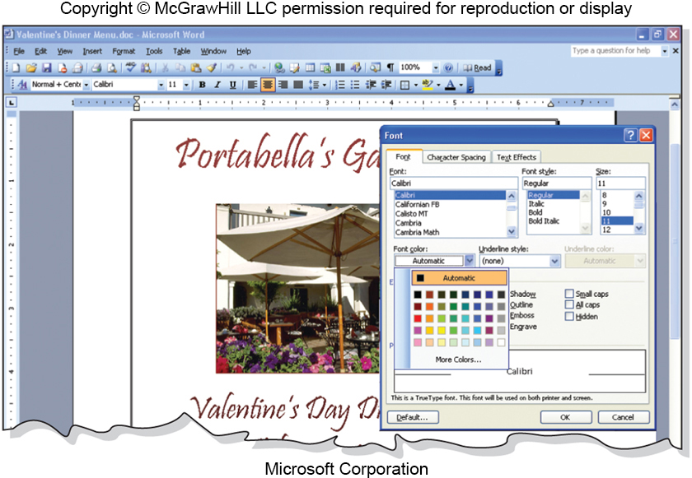
User Interface
Icons
Pointer
Windows
Menus
Menu bar.
Toolbars
Buttons.
Dialog Boxes
Access the text alternative for slide images.
Notes:
User interface (key term) or Graphical User Interface (GUI) (key terms) allows the user to control and interact with the program.
Graphical elements called Icons (key term) can be clicked on by the user using the mouse.
The mouse controls the pointer (key term) on the screen to select the icon
Once the icon is selected and clicked, the represented program will display in the window (key term) which is the rectangular area containing a document, program or message.
Most programs use a system of menus, toolbars, and dialog boxes.
Menus (key term) present commands that are displays in the menu bar (key term) at the top of the screen
Toolbars (key term) appear below the menu bar (key term) and include graphic elements known a buttons (key term) the user can click on as a shortcut
Dialog Boxes (key term) provide additional information and request user input

Slide 6
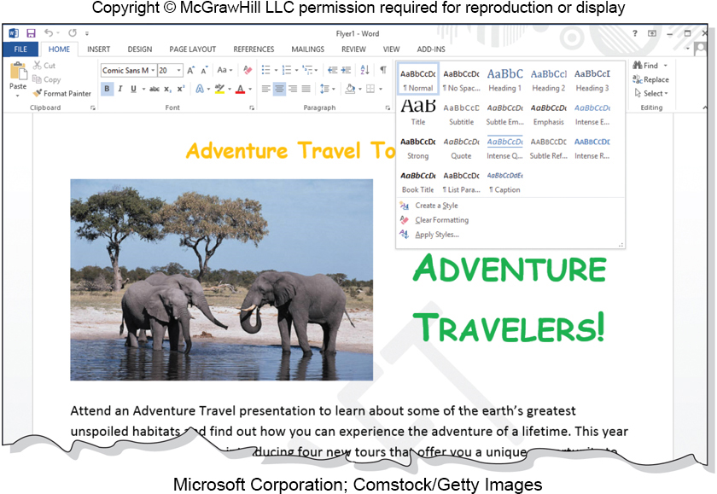
Common Features in Microsoft
Ribbon G U I
Ribbons.
Tabs.
Groups.
Contextual tabs.
Galleries.
Spell checkers
Alignment
Font and Font Sizes
Access the text alternative for slide images.
Notes:
Ribbon GUI (key term) makes it easier for the user to find and use all the features of an application
Ribbons (key term) replace menus and toolbars using commands into a set of tabs
Tabs (key term) divide the ribbon into major categories. Each tab represents groups (key term) of related items.
Contextual tabs (key term) are only used when the item is selected and at that time, operations can be performed on that item.
Galleries (key term) give the user to see the effect their selection will have prior to making their choice.
Most applications provide us with some variety of things such as
Spell Check
Alignment
Font and Font Sizes

Slide 7
Mobile Apps
Mobile applications, often referred to simply as Apps
Programs for a variety of mobile devices.
Examples include: address books, lists, alarms.
Apps can be used on both mobile and other devices
Over 3.5 million aps on Google Play alone.
Music, video, social networking, shopping, games.
Privacy
Often constantly recording location, photos taken, and businesses visited.
Concerns regarding unintended use, such as employers using data recorded by apps when evaluating job candidates.
Notes:
Mobile Applications often referred to simply as Apps
Most commonly developed for mobile use, but often work on a variety of devices
Enable users to access multimedia including music, video, social networking, shopping
Privacy concerns related to apps often tracking user actions and locations

Slide 8
General Purpose Applications
Word processors.
Spreadsheets.
Presentation programs.
Database management systems.

Slide 9
Word Processor Programs
Create text-based documents
Memos, letters, and reports.
Newsletters, manuals, and brochures.
Word processing programs
Microsoft Word.
Apple Pages.
Google Docs.
Notes:
Word Processor Programs (key term)
One of the most flexible and widely used software tools used to create documents (key term)
One of the first programs used by PC end-users
Microsoft Word is the most used word processor program

Slide 10
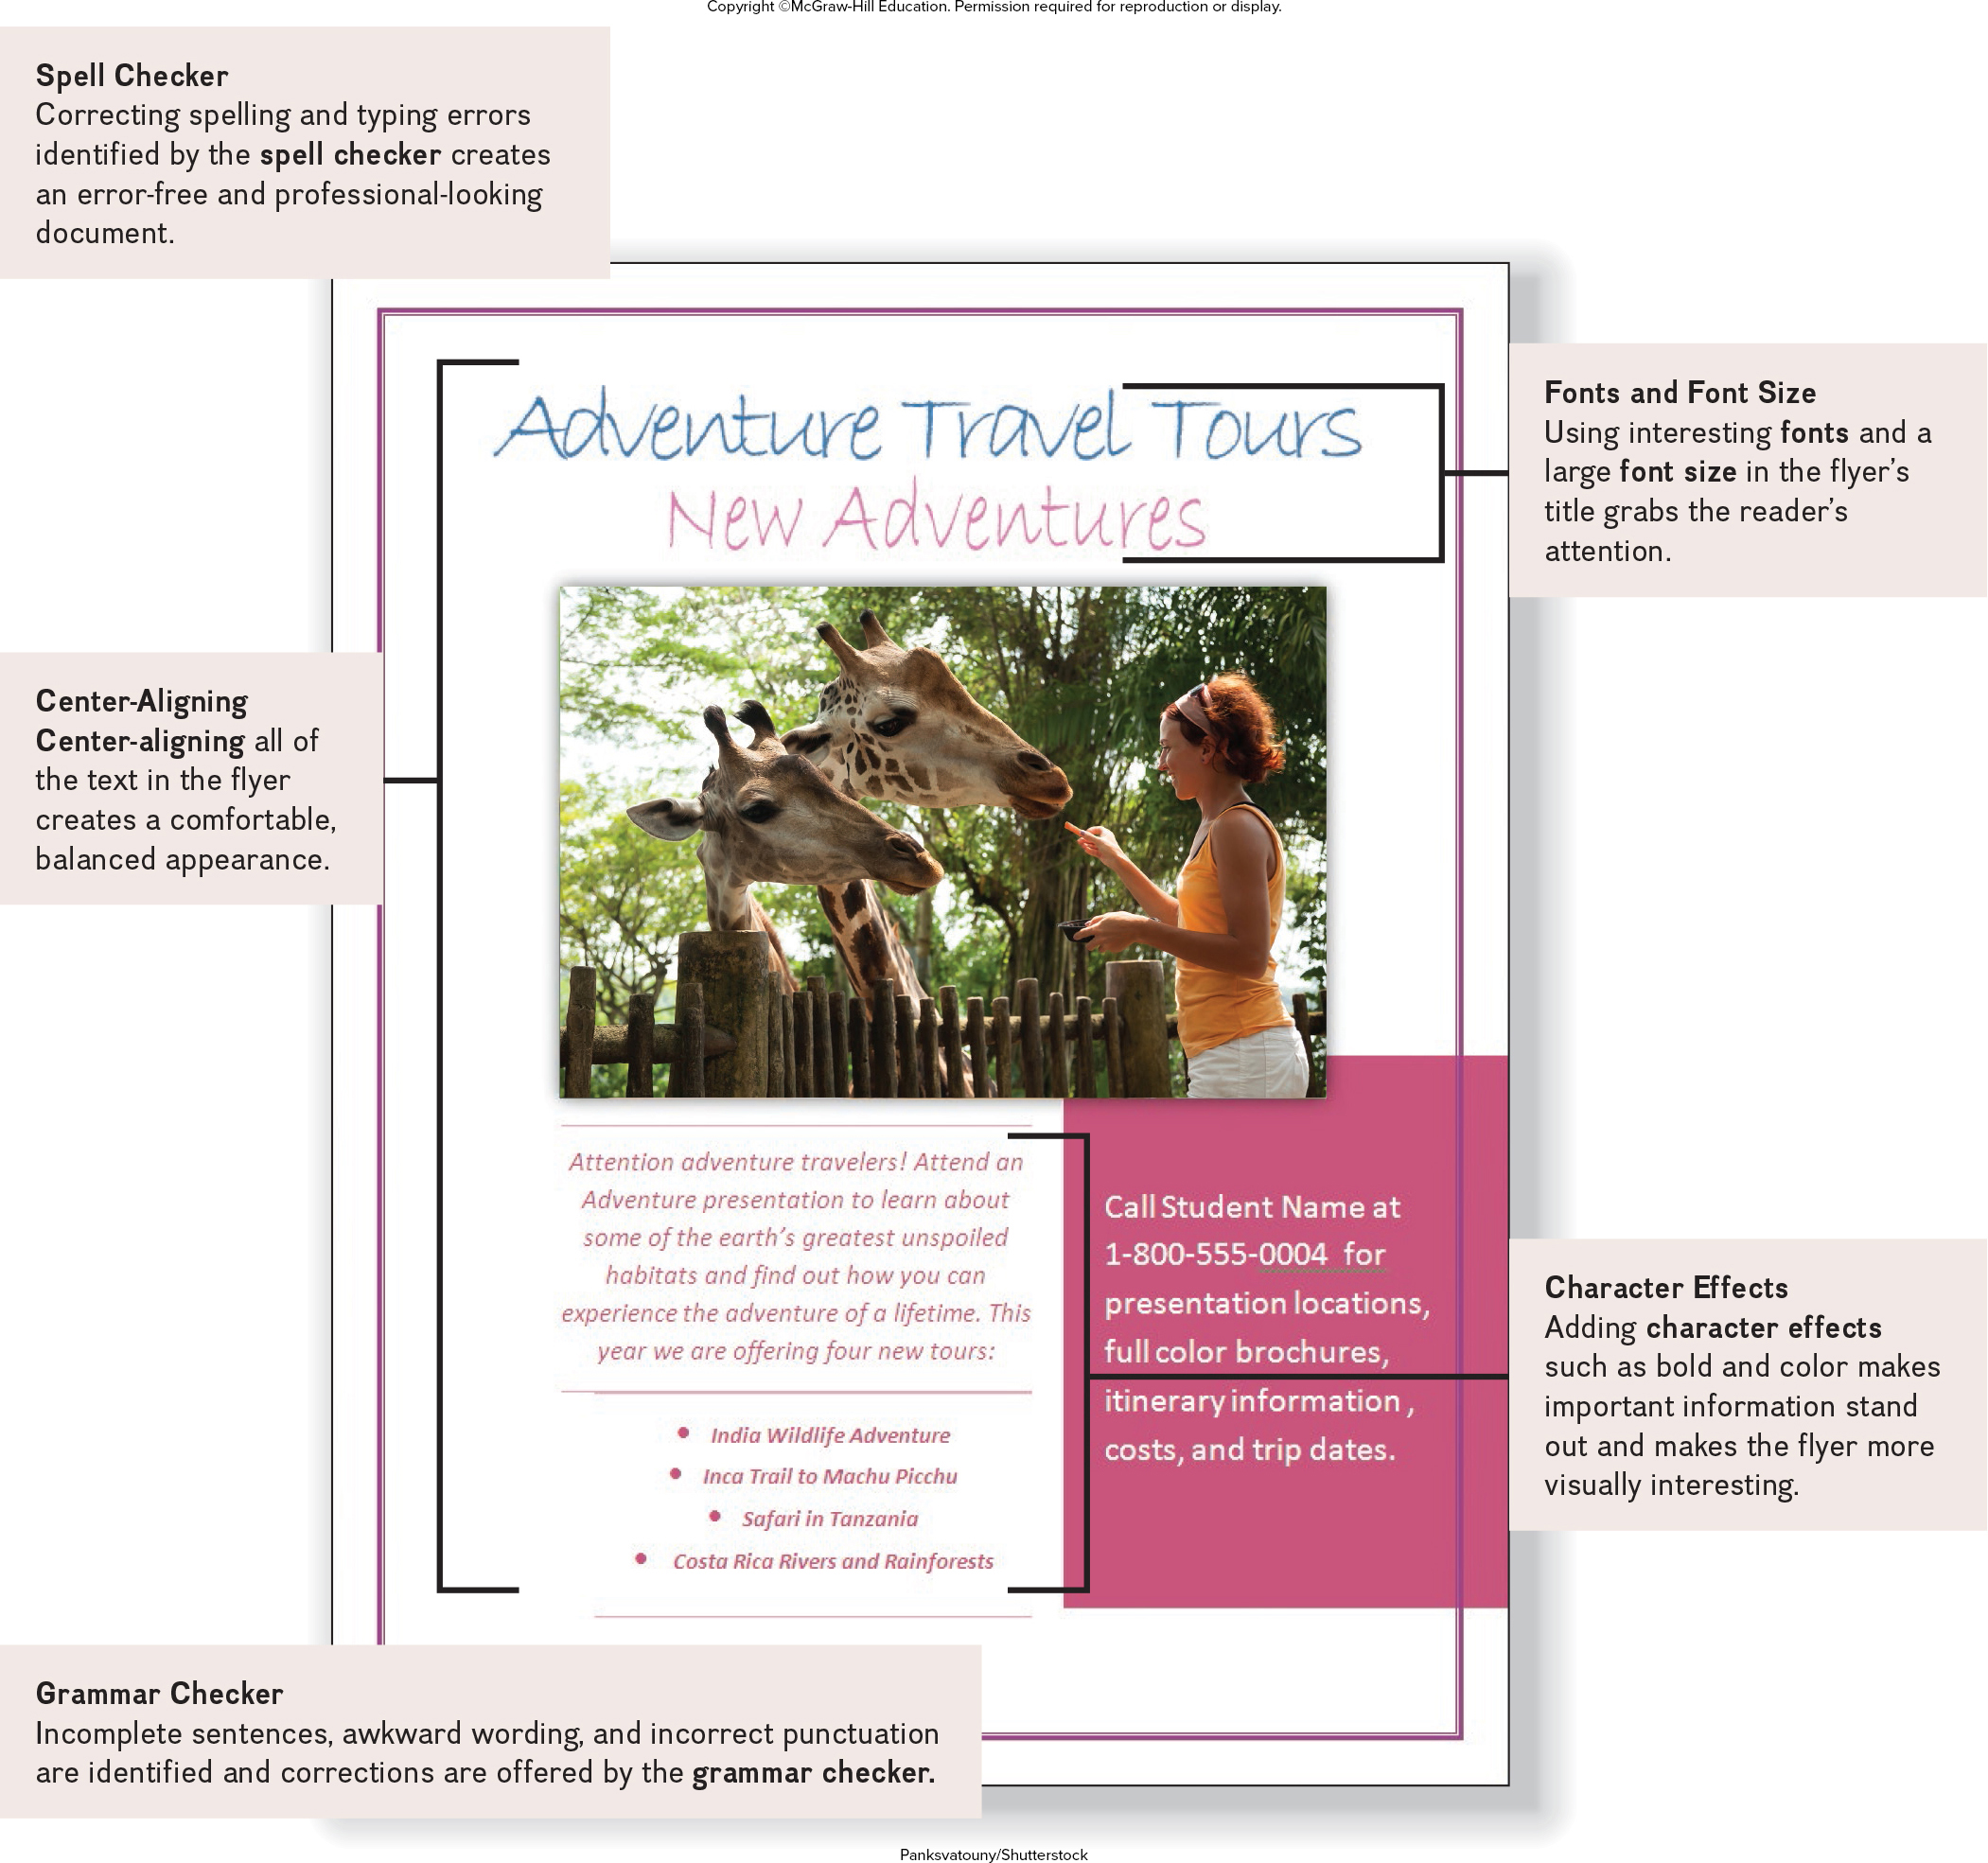
Creating a Flyer
Flyer Features
Spell Checker.
Center-alignment.
Grammar Checker.
Fonts.
Font Sizes.
Word Wrap.
Character Effects.
Access the text alternative for slide images.
Notes:
Features of a flyer including:
Spell Checker
Fonts and Font Size
Character Effects
Grammar Checker
Center Alignment
You have been asked to create a promotional advertising flyer. After discussing the flyer’s content and basic structure with your supervisor, you start to enter the flyer’s text. As you enter the text, the spell checker and grammar checker catch some spelling and grammatical errors. Once the text has been entered, you proofread the text and then focus your attention on enhancing the visual aspects of the flyer. You add a photograph and experiment with different character and paragraph formats, including fonts, font sizes, colors, and alignments.

Slide 11
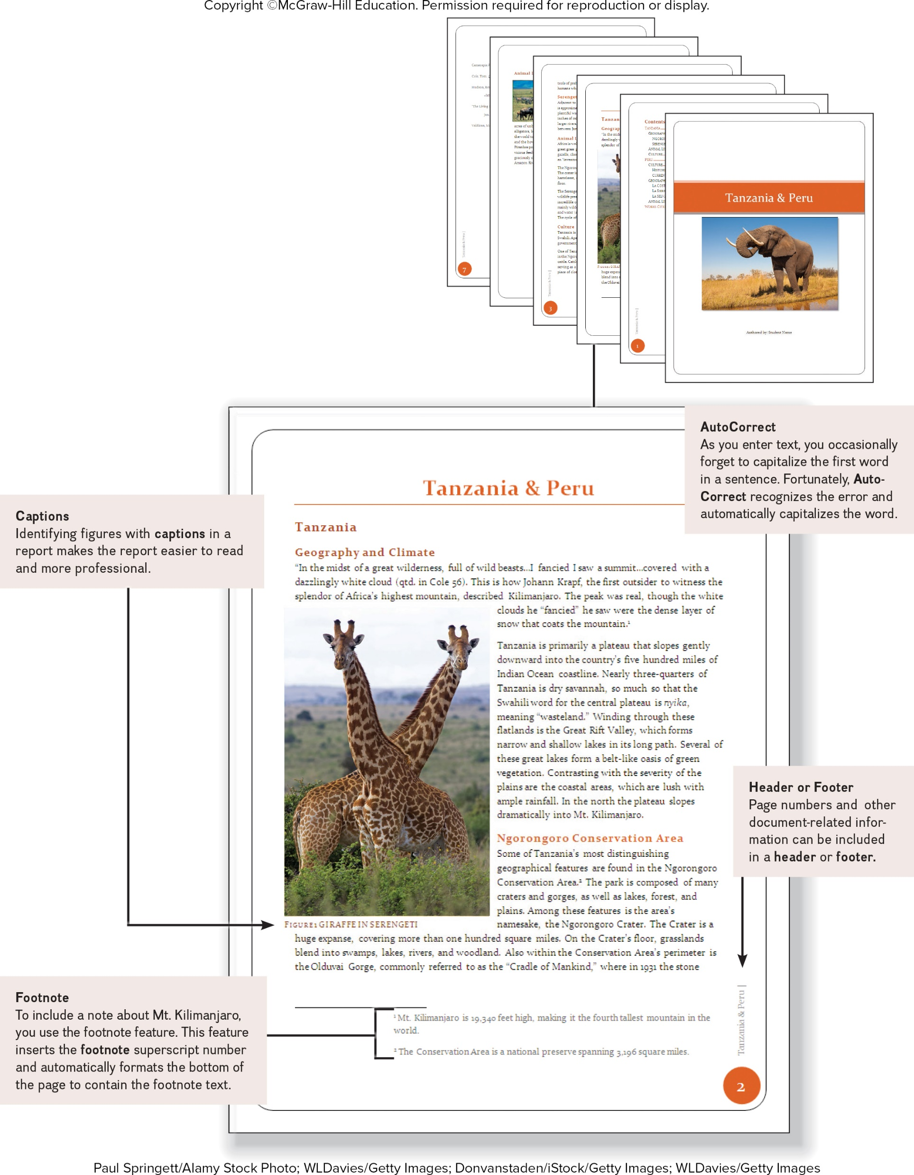
Creating a Report
Report Features
AutoCorrect.
Footnote.
Header or Footer.
Captions and Cross References.
Access the text alternative for slide images.
Notes:
Report features
AutoCorrect
Footnote
Header or footer
Captions and cross references
Your next assignment is to create a report on Tanzania and Peru. After conducting your research, you start writing your paper. As you enter the text for the report, you notice that the AutoCorrect feature automatically corrects some grammar and punctuation errors. Your report includes several figures and tables. You use the captions feature to keep track of figure and table numbers, to enter the caption text, and to position the captions. You use the footnote feature to assist in adding notes to further explain or comment on information in the report.
Finally, you prepare the report for printing by adding header and footer information.

Slide 12
Presentation Graphics Programs
Combine a variety of visual objects to create visually interesting presentations
Presentation programs
Microsoft PowerPoint.
OpenOffice Impress.
Apple Keynote.
Google Slides.
Prezi.
Notes:
Presentation graphics program (key term)
Creates interesting and professional presentations

Slide 13
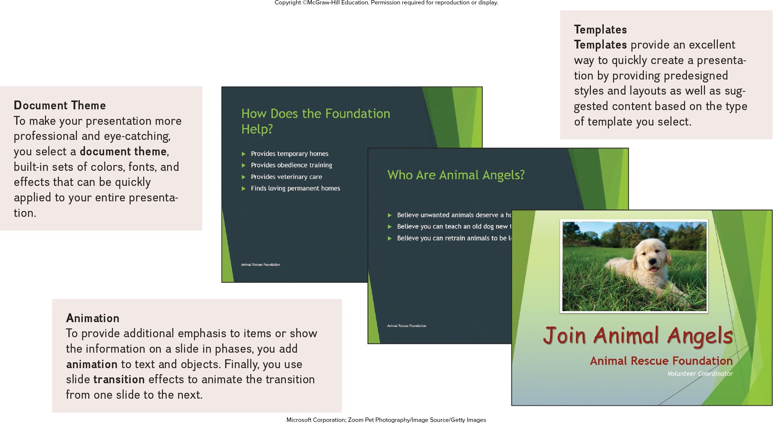
Creating a Presentation
Features
Document Theme.
Animation.
Templates.
Access the text alternative for slide images.
Notes:
Document Theme (key term) make your presentation more professional and eye catching
Animation (key term) to provide additional emphasis on items or show the information on a slide
Templates (ley term) provides predesigned styles and layouts to quickly create a presentation
You have been asked to create a powerful and persuasive presentation for the director of the foundation designed to encourage other members from your community to volunteer. The first step is to meet with the director of the foundation to determine the content of the presentation. Then using PowerPoint, you begin creating the presentation by selecting a presentation template and document theme. After entering the content, you add interest to the presentation by adding animation to selected objects and using slide transition effects.

Slide 14
Spreadsheet Programs
Organize, analyze, and graph numeric data
Budgets and Financial Reports.
Spreadsheet programs
Microsoft Excel.
Apple Numbers.
Google Sheets.
Notes:
Spreadsheet program (key term)
Organize, analyze and graph numeric data such as budgets and financial reports
The most widely used in Microsoft Excel. Other spreadsheet applications include Apple Numbers, and Google Sheets

Slide 15
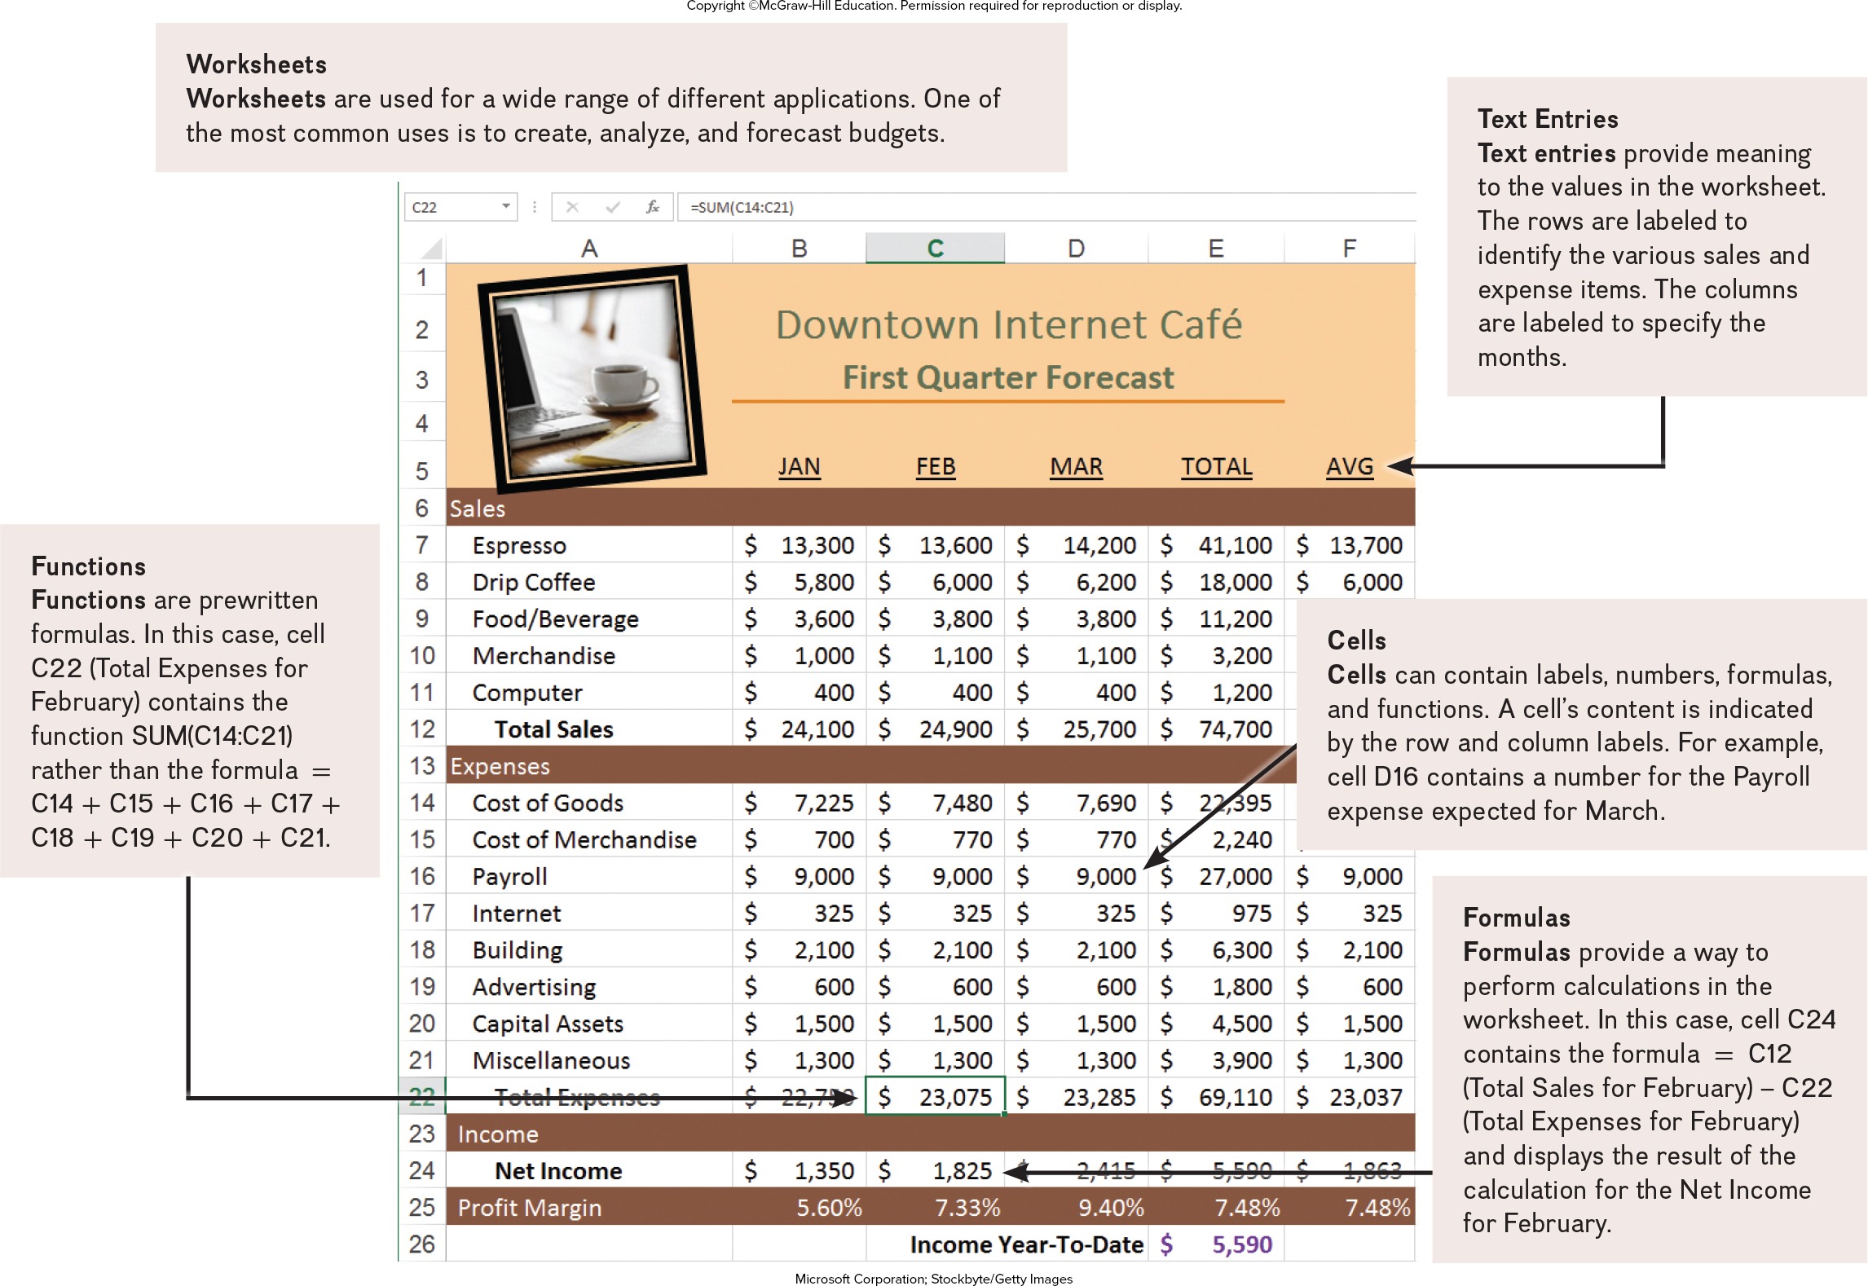
Creating a Sales Forecast
Features
Worksheets.
Text entries.
Cells.
Formulas.
Functions.
Access the text alternative for slide images.
Notes:
Features
Worksheets
Text Entries
Cells
Formulas
Functions
Your first project is to develop a first-quarter sales forecast for the café. You begin by studying sales data and talking with several managers. After obtaining sales and expense estimates, you are ready to create the first-quarter forecast. You start structuring the worksheet by inserting descriptive text entries for the row ad column headings. Next, you insert numeric entries, including formulas and functions to perform calculations. To test the accuracy of the worksheet, you change the values in some cells and compare the recalculated spreadsheet results with hand calculations.

Slide 16
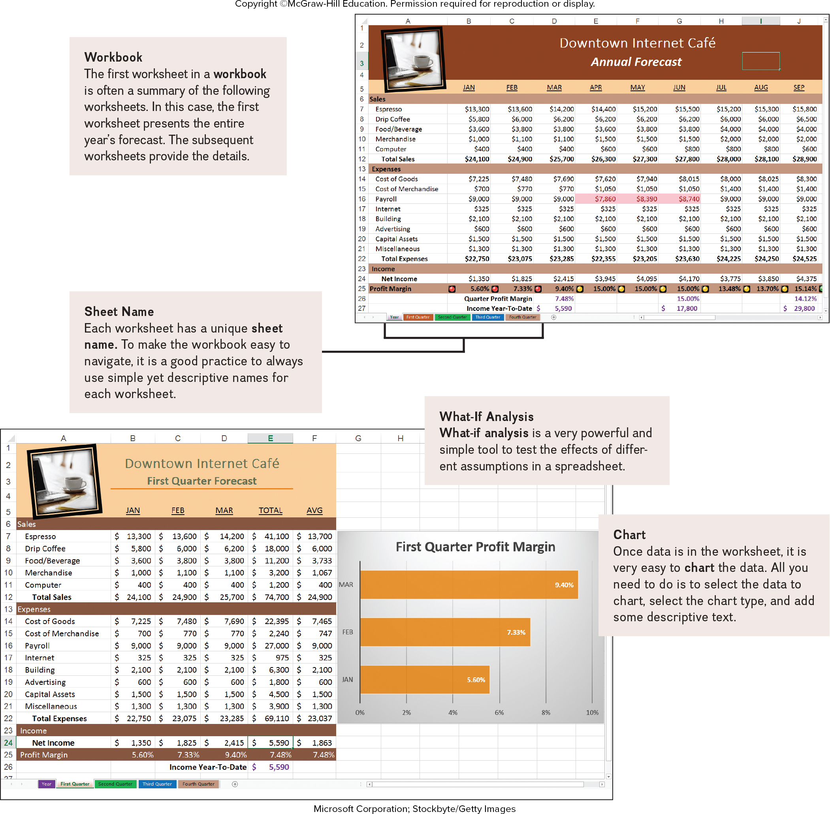
Analyzing Your Data
Features
Workbook and worksheets.
What-if Analysis.
Access the text alternative for slide images.
Notes:
Features
Workbook and worksheets
What-if analysis
After presenting the First-Quarter Forecast to the owner, you revise the format and expand the workbook to include worksheets for each quarter and an annual forecast summary. You give each worksheet a descriptive sheet name. At the request of the owner, you perform a what-if analysis to test the effect of different estimates for payroll, and you use chart to visualize the effect.

Slide 17
Database Management Systems (D B M S)
A collection of related data
Electronic equivalent of a file cabinet
Three most widely used systems
Microsoft Access.
Apple FileMaker.
Oracle Database Express Edition.
Notes:
Database (key term) is a collection of related data
Database Management Systems (DBMS) (key term) or a Database Manager (key term) – program that sets up or structures a database
Establishes a structure for data storage, usually relational – using related tables, so related data can be easily retrieved

Slide 18
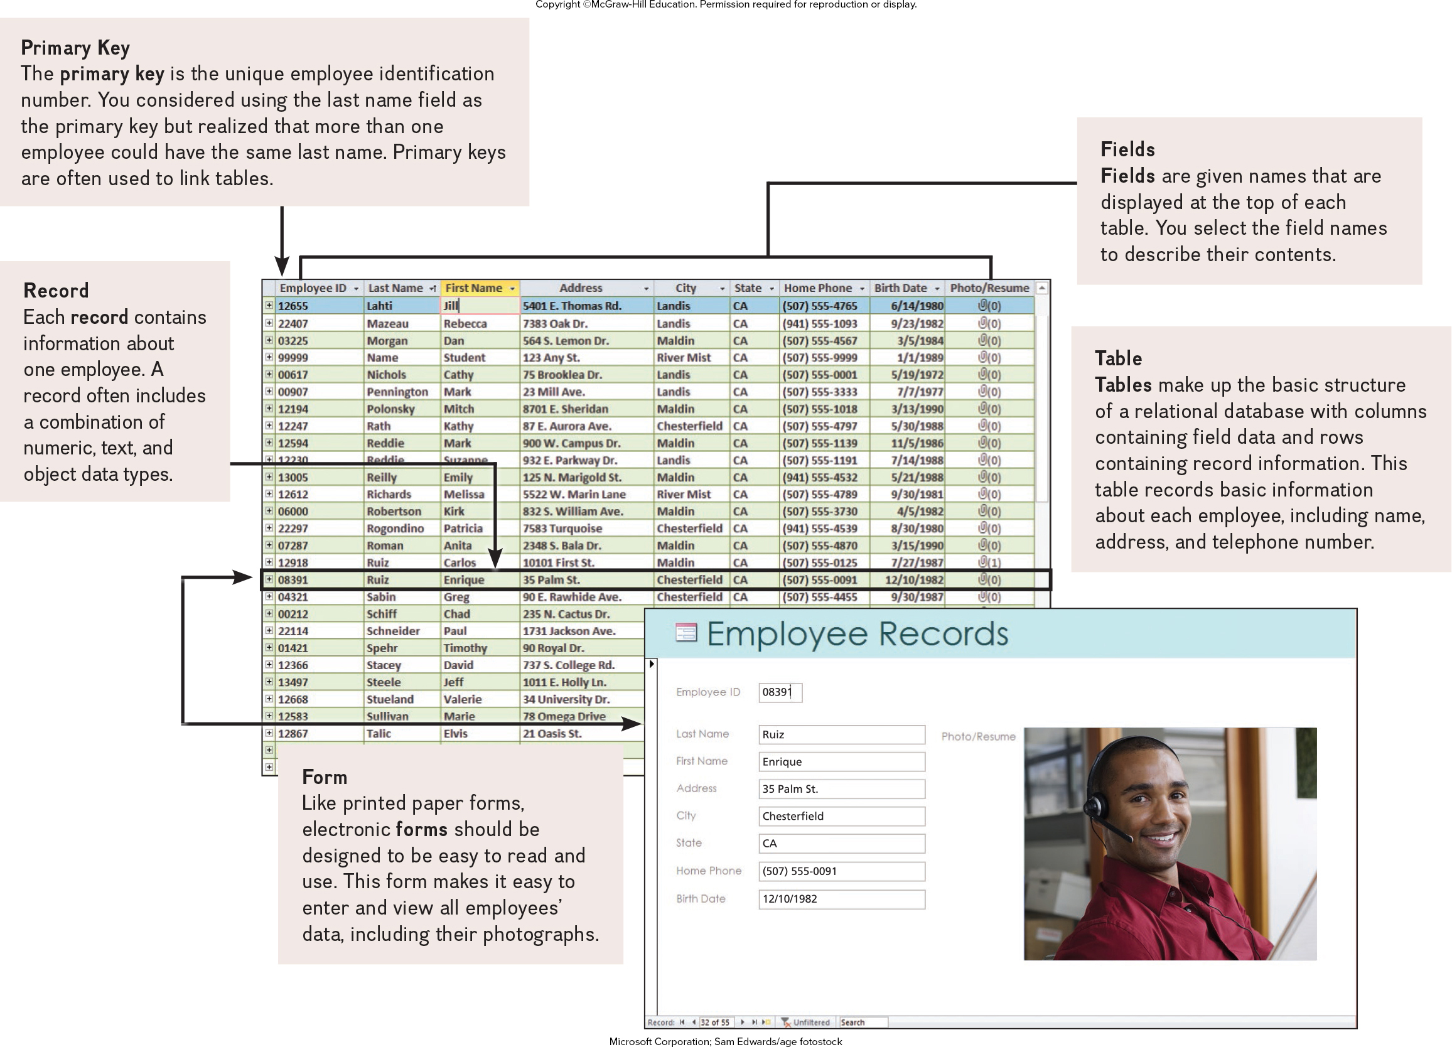
Creating a Database
Features
Primary Key.
Fields.
Tables.
Forms.
Records.
Access the text alternative for slide images.
Notes:
The first step is to plan the database
Feature list
Primary key
Field
Table
Form
Record
You have been asked to create an employee database to replace the club’s manual system for recording employee data. The first step in creating the database management system is to plan. You study the existing manual system focusing o how and what data is collected and how it is used. Next, using Microsoft Access, one of the most widely used DBMS programs, you design the basic structure or organization of the new database system to include a table that will make entering data and using the database more efficient. You create the table structure by specifying the fields and primary key field. To make the process faster and more accurate, you create a form and enter the data for each employee as a record in the table.

Slide 19
Specialized Applications
Programs that more narrowly focused on specific disciplines and occupations
Includes:
Graphics programs.
Web Authoring programs.
Notes:
Specialized applications included graphics programs and web authoring programs.

Slide 20
Graphics Programs
Widely used in graphic arts
Types of graphics programs are:
Video editors.
Image or photo editors.
Illustration or drawing programs.
Desktop publishing programs.
Notes:
Graphics programs are a type of specialized application used in graphic arts.
Video Editors
Edit videos to enhance quality and appearance
Can now use your smartphone to edit videos
Well-known programs
Adobe Premier Elements 2021
Apple iMovie
Movavi Video Editor
Image Editing Programs
Also know as Photo Editors
Editing or modifying digital photographs
Photographs consist of thousands of pixels that form images known as bitmaps
Popular image editors
Adobe Photoshop
Microsoft Photo
Apple’s Photos
Illustration Programs
Drawing programs
Create and edit vector images
Vector illustrations
Geometric shapes or objects
Created by connecting lines and curves
Defined by mathematical equations
Popular Illustration Programs
Adobe Illustrator
Procreate
Autodesk Sketchbook
Desktop Publishing Programs
Also known as Page Layout Programs
Mix text and graphics to create publications
Popular programs:
Adobe InDesign
Microsoft Publisher
QuarkXPress

Slide 21
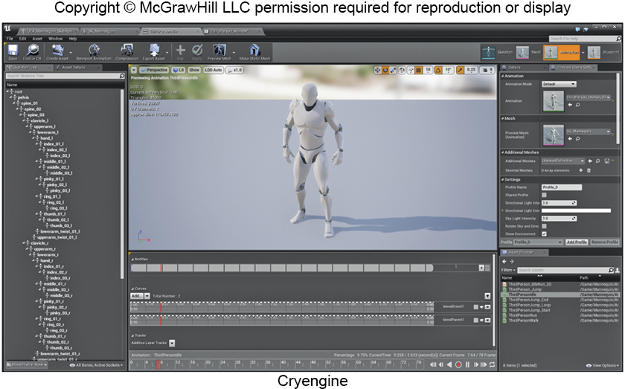
Video Game Design Software
Organize thoughts
Guide user through game design process
Character development.
Environmental design.
Video game design software ranges from free to expensive for professional game designers
Unreal Game Engine.
Unity development kit.
GameMaker Studio 2.
Notes:
Video Game Design Software (key term) – First step is to visualize the game by thinking about the game’s length and plot. Second steps is to choose the right video game design software.

Slide 22
Web Authoring Programs
Web authoring is the creation of a website
Design.
Document file displaying website’s content.
Blog
Online diary/commentaries.
Web Authoring Programs
Typically used to create commercial sites.
Web page editors or H T M L editors.
WYSIWYG (what you see is what you get).
Most widely used programs
Adobe Dreamweaver.
Froala 4.0.
Notes:
There are over a billion websites on the Internet and more being created and added as we speak.
Anything from corporations promoting their products to individuals creating online diaries or blogs (key term).
It all begins with web authoring (key term) or the creation of a site through a Web Authoring program (key term).
It starts with the design and then the document file displaying the website’s content.
Some web authoring programs are WYSIWYG (key term) what you see is what you get which means you can build the page without having to interact or understand coding (HTML)
Web page editors (key term) or HTML editors (key term) provide support for website design and HTML coding

Slide 23
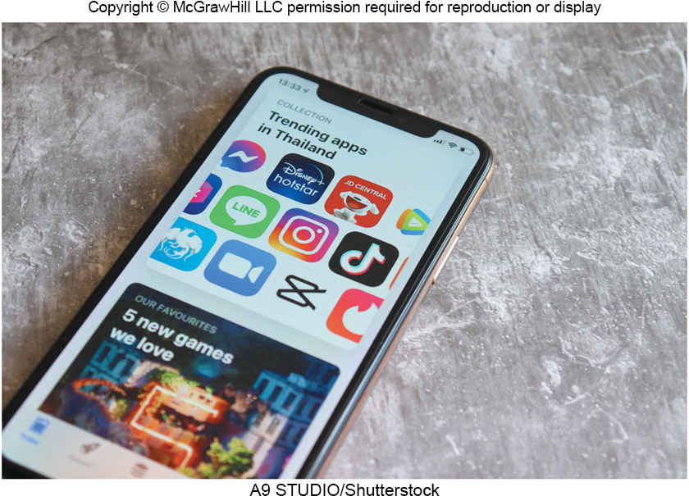
App Stores
Provides access to mobile apps for downloads
Apple’s App Store.
Apple Devices.
https://www.apple.com/app-store/
Google Play.
Android Devices.
https://play.google.com/store/apps.
Notes:
App Stores (key term)
Provide access to mobile apps either for free or a fee
Most popular
Apple’s App Store
Google Play

Slide 24
Software Suites
Collection of separate application programs
Bundled together – made available as group.
Four types of suites
Office suites or office software suite / productivity suites
Microsoft Office.
Apple iWork,
Cloud suites or online office suites
Google Workspace.
Microsoft 365.
Apple iWorks.
Notes:
Office Software Suite (ley term) / Office Suite (key term) / Productivity Suite (key term)
A collection of separate applications bundled and sold as a group that share information between applications
Less expensive than individual applications; but more expensive than integrated packages
Cloud Suites (key term) or online office suites (key term) are stored at a server on the Internet and access is gained through the Internet.
Ease in collaboration
Downside – dependent on server so be sure to have a backup

Slide 25
Software Suites, continued
Specialized suites
Focus on specific applications.
Adobe Creative Cloud.
Magix’s Sound Forge Pro 15.
Moneytree Software Total Planning Suite.
Utility suites
Designed to make computing easier and safer.
Iolo’s System Mechanic Ultimate Defence.
AVG TuneUp.
Notes:
Specialized suites (key term) include graphics or financial suites among others. The most popular are Adobe Creative Cloud and Moneyfree Software TOTAL Planning Suite.

Slide 26
Careers in IT
Software Engineers
Analyze users’ needs and create application software.
Attributes
Bachelor’s or specialized advanced associate’s degree in computer science or information systems.
Extensive knowledge of computers and technology.
Good communication and analytical skills.
Web application experience.
Analytical skills.
Earning potential of $63,000 to $148,000 annually
Notes:
Software Engineers (key term) analyze users’ needs and create application software.
Typically have experience in programming but focus on the design and development of programs using the principles of mathematics and engineering.

Slide 27
Making IT Work for You – Cloud Office Suites
Things to consider when choosing a cloud office suite:
What does your team use now?
How experienced are your teammates?
Storage options.
Prices.
Choose a suite and put it to work for you!

Slide 28

A Look to the Future
V R and A R Applications in the Workplace
Notes:
Review the Look to the Future in the chapter.
VR and AR Applications in the Workplace
Reducing our needs to physically visit the office
Drastically changing and improve the way business is conducted
Could even remove the need for VR and AR glasses in the near future

Slide 29
Open Ended Questions
Explain the difference between general-purpose and specialized applications. Also discuss the common features of application programs, including those with traditional and ribbon graphical user interfaces.
Discuss general-purpose applications including word processors, spreadsheets, database management systems, and presentation graphics.
Discuss specialized applications, including graphics programs, video game design software, web authoring programs, and other professional specialized applications.
Describe mobile apps, including popular apps and app stores.
Describe software suites, including office suites, cloud suites, specialized suites, and utility suites.
Notes:
Have students turn to the end of Chapter 3 in their textbooks to view the same “Open-Ended” questions/statements

Slide 30
End of Main Content
© McGraw Hill LLC. All rights reserved. No reproduction or distribution without the prior written consent of McGraw Hill LLC.

